Slide 1
PROJECT – 3 OPERATION ANALYTICS AND INVESTIGATING METRIC SPIKE By Deeksha

Slide 2
Project analysis slide 2
TABLE OF CONTENTS
Project Description
Approach
PROJECT
Tech-Stack Used
Insights
Result

Slide 3
Project analysis slide 3
PROJECT DESCRPTION
A portion of data analytics called "operation analytics" is primarily concerned with increasing the effectiveness of business operations. It demonstrates how various operations are now run and how they might be enhanced for increased profitability. As part of this effort, I've answered issues like these that are frequently posed by the many departments in a corporation the marketing team, the operations team, and other teams that are necessary to boost effectiveness and streamline.
Operation analytics includes analysing metric spikes heavily. The metric spike demonstrates the trend abnormality. It provides answers to issues like why there has been a decline in everyday engagement. Why have sales fallen off? These inquiries must be addressed on a daily or weekly basis and must be taken seriously. Different data sets are provided for this task.

Slide 4
Project analysis slide 6
APPROACH
Understanding the offered data and tables. I've taken the effort to comprehend the significance of each field in the data collection, including job_id, actor_id, and event. They were able to use this to establish the important considerations when reviewing the data..
Use your SQL expertise to glean information. I used my SQL expertise to mine the data collection for insightful information. In order to do this, the data had to be queried, and queries could then be answered using the findings..
Build a database. To hold the data set, a database was made. Accessing and managing the data became simpler as a result.
Make the data more easily available and organized for analysis. My efforts to comprehend the data, apply my SQL knowledge, build a database, and design tables improved the organization and analysis-ability of the data. They will therefore be able to respond to more difficult queries and gain deeper insights into the data.
Loaded the dataset into the MYSQL workbench by using the command LOAD INFILE..
Create tables utilizing the team's relationships and organizational structure. Using the structure and relationships that the management team provided, I created the database's tables. By doing this, it was made sure that the data was arranged logically and was simple to utilize.

Slide 5

Project analysis slide 10
TECH-STACK USED
I utilized SQL (Ver 8.0.34), which I downloaded from the document's URL, and then I downloaded SQL WORKBENCH (Ver 8.0.34), which offers a visual console for managing MySQL systems and improving database visibility.
.

Slide 6
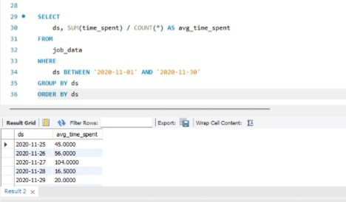
Project analysis slide 10
INSIGHTS
Case Study 1: Job Data Analysis
1. Determine how many jobs are examined per hour for each day in November 2020.
SELECT
ds, SUM(time_spent) / COUNT(*) AS avg_time_spent
FROM
job_data
WHERE
ds BETWEEN '2020-11-01' AND '2020-11-30'
GROUP BY ds
ORDER BY ds;
.

Slide 7
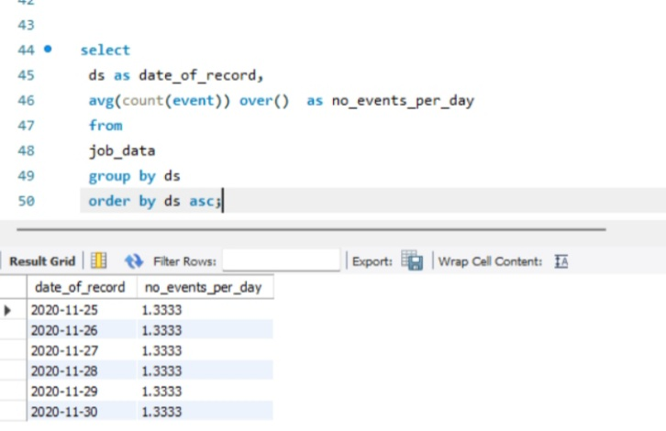
Project analysis slide 10
INSIGHTS
2. Calculate the 7-day rolling average of throughput (number of events per second). Additionally, explain whether you prefer using the daily metric or the 7-day rolling average for throughput, and why.
The underlying trend is more accurately represented by the 7-day rolling average, which tames daily fluctuations.
select
ds as date_of_record,
avg(count(event)) over() as no_events_per_day
from
job_data
group by ds
order by ds asc;
.

Slide 8
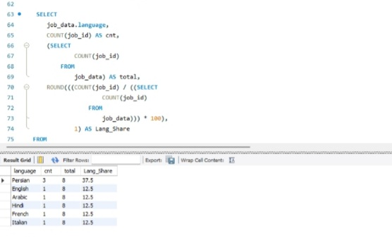
Project analysis slide 10
INSIGHTS
3. Determine the 30 day average % share of each language.
SELECT job_data.language, COUNT(job_id) AS cnt,
(SELECT COUNT(job_id)
FROM
job_data) AS total,
ROUND(((COUNT(job_id) / ((SELECT
COUNT(job_id)
FROM
job_data))) * 100),
1) AS Lang_Share
FROM job_data
GROUP BY job_data.language
ORDER BY Lang_Share DESC;
.

Slide 9
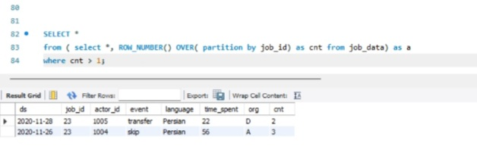
Project analysis slide 10
INSIGHTS
4. Identify duplicate rows in the data.
SELECT *
from ( select *, ROW_NUMBER() OVER( partition by job_id) as cnt from job_data) as a
where cnt > 1;
.

Slide 10
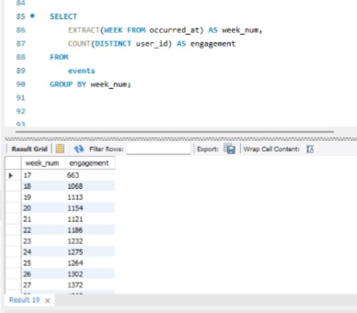
Project analysis slide 10
INSIGHTS
Case Study 2: Investigating Metric Spike
1. Measure the activeness of users on a weekly basis.
SELECT
EXTRACT(WEEK FROM occurred_at) AS week_num,
COUNT(DISTINCT user_id) AS engagement
FROM
events
GROUP BY week_num;
.

Slide 11
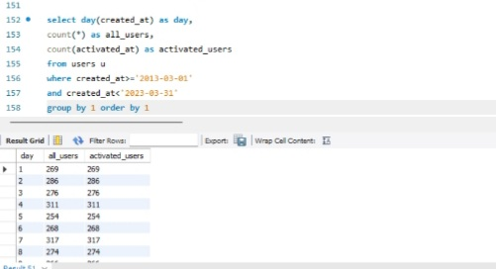
Project analysis slide 10
INSIGHTS
2. Analyze the growth of users over time for a product.
select day(created_at) as day,
count(*) as all_users,
count(activated_at) as activated_users
from users u
where created_at>='2013-03-01'
and created_at<'2023-03-31'
group by 1 order by 1
.

Slide 12
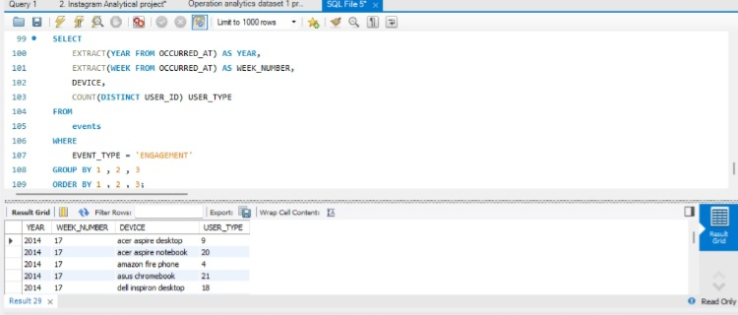
Project analysis slide 10
INSIGHTS
3. Analyze the retention of users on a weekly basis after signing up for a product.
SELECT
EXTRACT(YEAR FROM OCCURRED_AT) AS YEAR,
EXTRACT(WEEK FROM OCCURRED_AT) AS WEEK_NUMBER,
DEVICE,
COUNT(DISTINCT USER_ID) USER_TYPE
FROM
events
WHERE
EVENT_TYPE = 'ENGAGEMENT'
GROUP BY 1 , 2 , 3
ORDER BY 1 , 2 , 3;
.

Slide 13
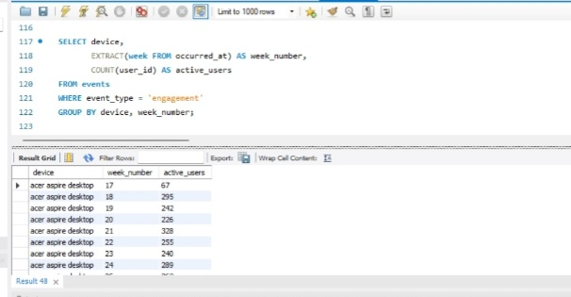
Project analysis slide 10
INSIGHTS
4. Measure the activeness of users on a weekly basis per device.
SELECT device,
EXTRACT(week FROM occurred_at) AS week_number,
COUNT(user_id) AS active_users
FROM events
WHERE event_type = 'engagement'
GROUP BY device, week_number;
.

Slide 14
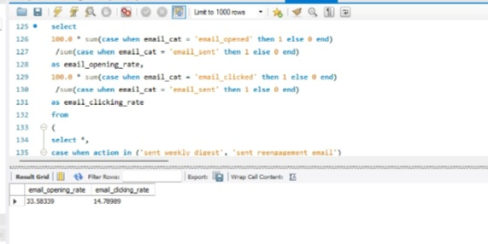
Project analysis slide 10
INSIGHTS
5. Analyze how users are engaging with the email service.
select
100.0 * sum(case when email_cat = 'email_opened' then 1 else 0 end)
/sum(case when email_cat = 'email_sent' then 1 else 0 end)
as email_opening_rate,
100.0 * sum(case when email_cat = 'email_clicked' then 1 else 0 end)
/sum(case when email_cat = 'email_sent' then 1 else 0 end)
as email_clicking_rate
from
(
select *,
case when action in ('sent_weekly_digest', 'sent_reengagement_email')
then 'email_sent'
when action in ('email_open')
then 'email_opened'
when action in ('email_clickthrough')
then 'email_clicked'
end as email_cat
from emailEvents
)a;
.

Slide 15
Project analysis slide 10
RESULT
I learned how to use sophisticated SQL ideas with this assignment. I was aware of how the market in the actual world operates. I was able to learn my SQL fundamentals as a result. I discovered how to ask the appropriate questions in light of the situation. How to extract the most insightful information that will help the business grow from the given data and queries, including which column to take into account. I discovered how the business identifies several business-related areas for improvement. I learned about metric spike investigation (why there is a boom and why there is a dip).
.

Slide 16
Thank You

